Slide 1
Nessus Demo - 1
Lets take a look at Nessus Demo
https://www.tenable.com/products/nessus/nessus-professional/evaluate
Download free 7 day trial
Get activation key from website

Slide 2
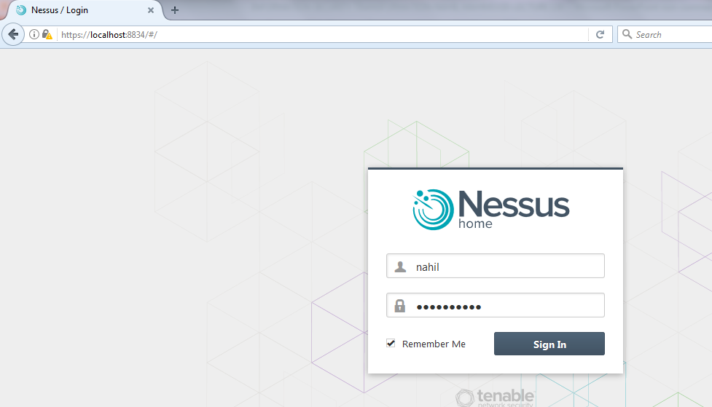
Nessus Demo - 1
LOGIN SCREEN

Slide 3
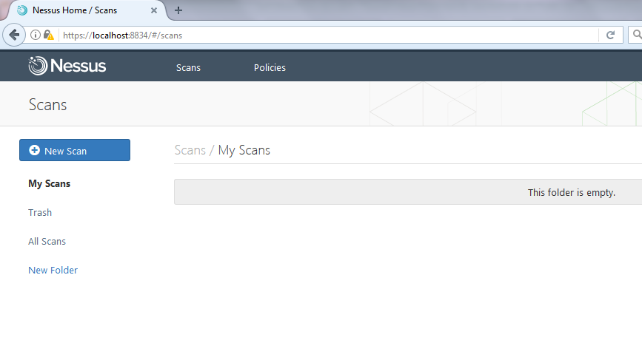
Nessus Demo - 1
DASHBOARD

Slide 4
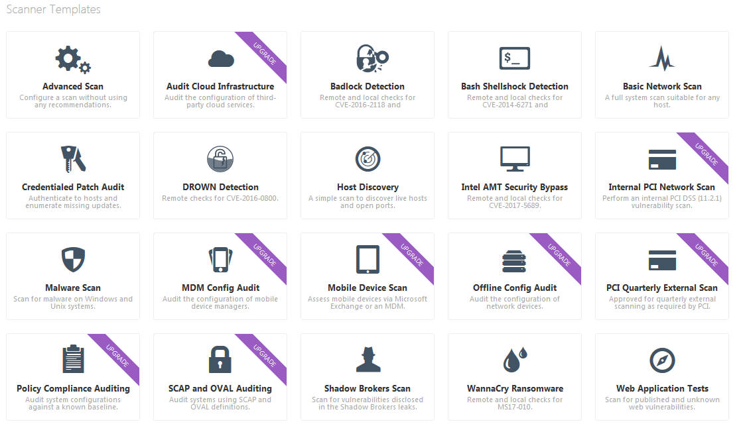
Nessus Demo - 1
NEW SCAN

Slide 5
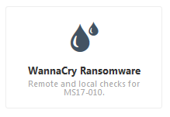
Nessus Demo - 1
WANNACRY RANSOMWARE SCAN

Slide 6
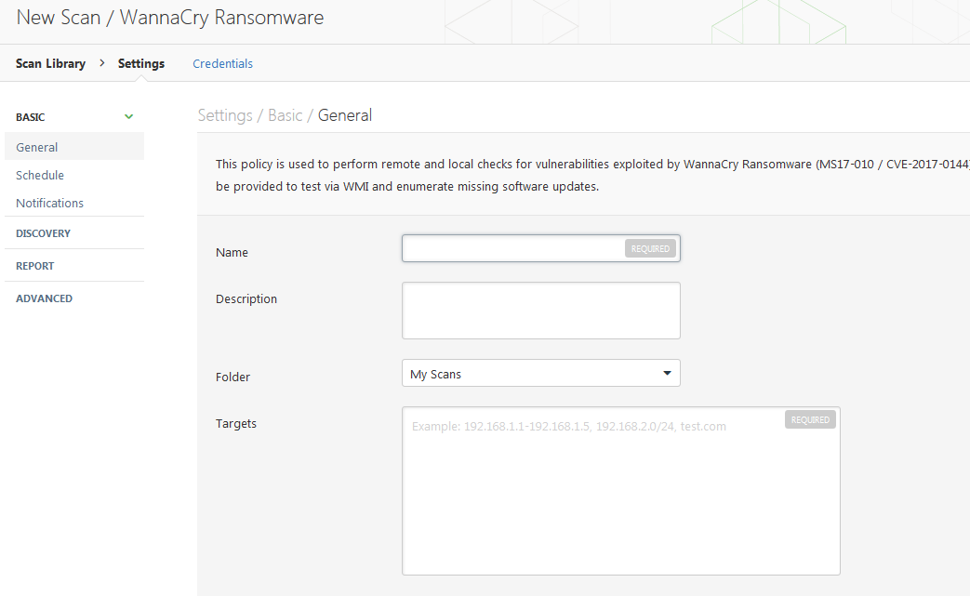
Nessus Demo - 1
NEW SCAN WINDOW

Slide 7
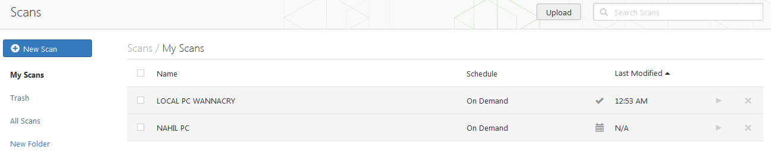
Nessus Demo - 1
DASHBOARD VIEW WITH SCANS

Slide 8
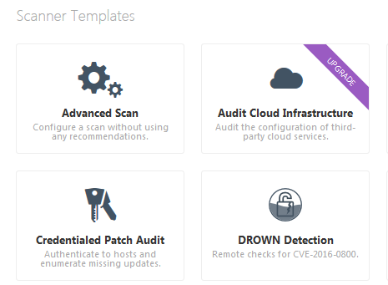
Nessus Demo - 1
NEW SCAN…

Slide 9
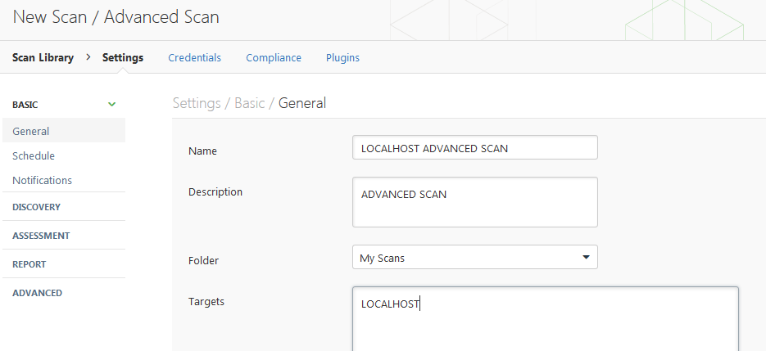
Nessus Demo - 1
ENTER SCAN DETAILS

Slide 10
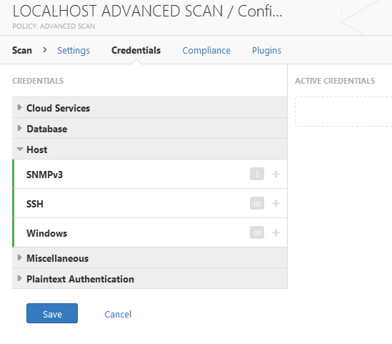
Nessus Demo - 1
CREDENTIAL SCAN

Slide 11
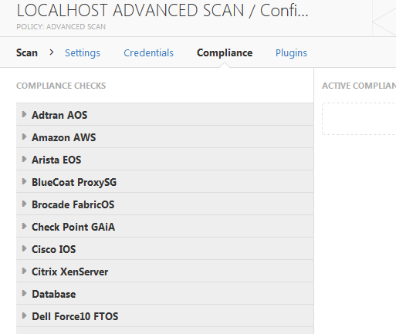
Nessus Demo - 1
COMPLIANCE SCAN

Slide 12
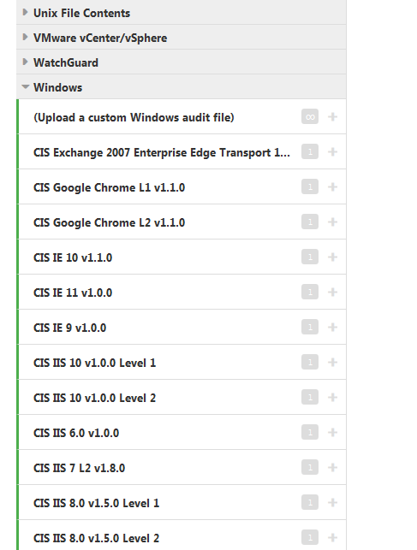
Nessus Demo - 1
WINDOWS COMPLIANCE MENU (CIS)

Slide 13
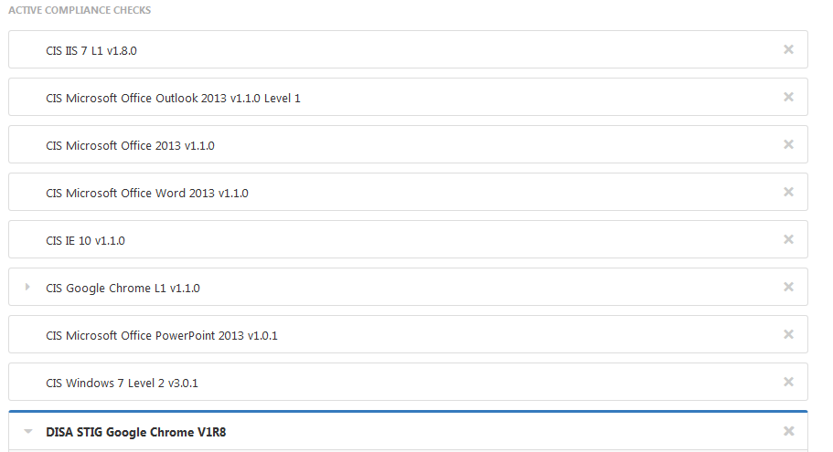
Nessus Demo - 1
WINDOWS COMPLIANCE MENU (CIS)…

Slide 14
Nessus Demo - 1
Lets take a look at Nessus Demo
https://www.tenable.com/products/nessus/nessus-professional/evaluate
Download free 7 day trial
Get activation key from website

